Slide 1

A new unit, a new jotter.
Your name
The existence of God
D003
Mrs Howie

Slide 2

Learning Intentions: We are starting by learning a bit about philosophy then in order to consider if God exists we will start by thinking about our own viewpoints and then explore the nature of God.
Success criteria: By the end of the lesson you will:
. Understand what philosophy is!
. Explain your own viewpoint on whether or not you believe in God.
. Understand the character of the God we are investigating.

Slide 3

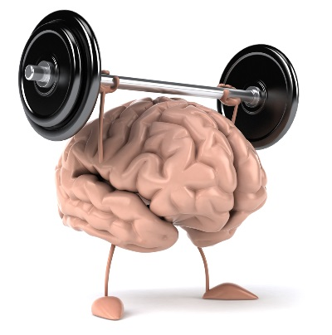
What is Philosophy?
Philo + Sophia = Love of Wisdom
(Love) (Wisdom)
It is also about…
It is..
A gym where we can flex the muscles of the mind
Thinking what is the best way to live your life.
Deciding what is right and wrong, good and bad.
Doubting what we think we know for sure.
Arguing in different ways.
Notes:
Scottish

Slide 4


If you paint over a window, is it still a window?
Notes:
Scottish

Slide 5
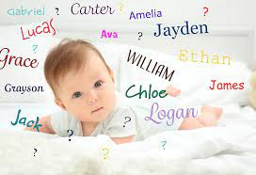
Does a person’s name influence the person they become?
Notes:
Scottish

Slide 6

What is the point of life?
Notes:
Scottish

Slide 7
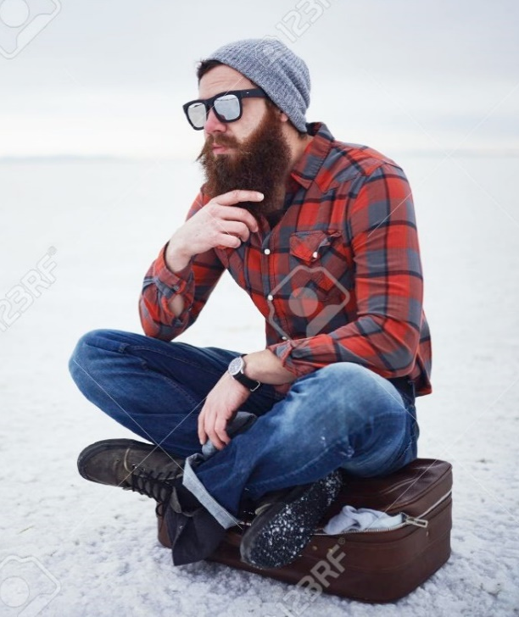
Introduction to the Existence of God
During this unit we will address the issue of GOD’S EXISTENCE.
We will consider the historical attempts to provide evidence to either prove or disprove God’s existence, and the ambiguity surrounding these attempts.
We will also explore how RELIGIOUS and NON RELIGIOUS people make decisions about the existence of God.
Sounds deep man!

Slide 8
The mandatory content
Existence of God mandatory content.
Does God exist?
. What arguments/theories do religious people use to prove the existence of God?
. What evidence do religious people use to support these arguments/theories?
. What are the strengths and weaknesses of evidence/arguments/theories?
. What arguments/theories do non-religious people use to challenge the existence of God?
. What evidence do non-religious people use to support these arguments/theories?
. What are the strengths and weaknesses of evidence/arguments/theories?
. Can either religious or non-religious arguments/theories provide conclusive proof about the existence of God?

Slide 9
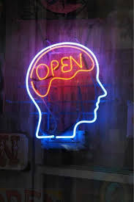
The starting point of this course must first be to establish what most people who believe in God have in mind when they talk about God.
To do this you must make every effort to consider what the philosophers and theologians mean(t) when they talk(ed) about God.
As well as considering your own opinion.
No one is going to tell you what to believe, or that your ideas are “wrong” but you need to be open to other ideas as well.

Slide 10
Very sure God exists
So as we start this unit lets think about our own beliefs, and then at the end of the unit we can see if our views have changed.
Imagine there is a line going down the classroom. Place yourself on the line depending on whether you believe in God or not.
The closer to the window that you are the more convinced you are that he exists.
Very sure God does not exist

Slide 11

Task:
10.11.22 My Opinions on the existence of God.
. Explain where you stood on the line.
. Tell me what you believe about God.
. Explain your reasons for that belief (or lack of belief).

Slide 12
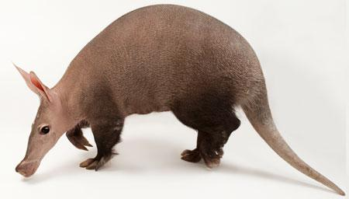
When trying to answer if a God exists there are a few things we need to think about.
Understanding what you’re looking for….
Before you begin trying to prove that anything exists the first key thing you must do is establish exactly what it is you’re looking for.
The modern day philosopher Peter Vardy makes this point by explaining that if you were asked to go on an expedition to find an aardvark you should first make sure that you know what an aardvark is. If you don’t then no matter how hard you try you’re simply not going to find one!
Just in case you don’t know this is an aardvark

Slide 13
Who God is
According to theologians God is a being who is :
• Radically different from anything that exists in the physical universe (spiritual not physical).
• Omniscient (all knowing)
• Omnipresent (present everywhere)
• Omnipotent (all powerful)
• Eternal (was not created but has always and will always exist)
• Benevolent (good/loving)
Sound familiar ?!
The “God” we are going to be studying is the theist God which is followed by Jews, Christians and Muslims.
This God has many similar characteristics.
Take a look at the 99 names of Allah. What similarities/ differences do you notice?

Slide 14
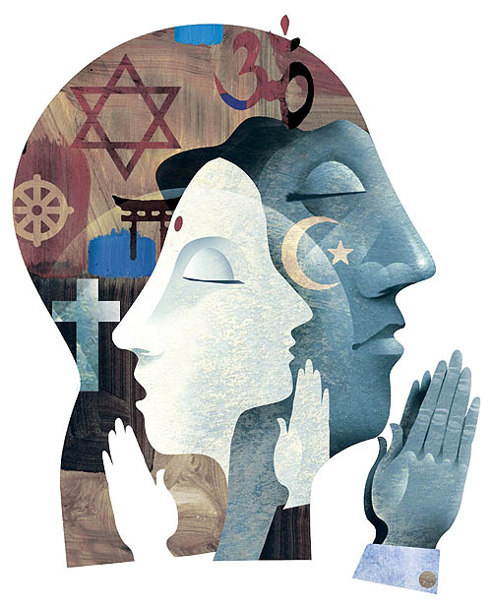


THEISTS believe that God exists
They are all convinced that there are good reasons to believe that God exists even if it cant be proven.
ATHEISTS don’t believe that God exists
Buddhists believe there is no such being as God and that there is no good evidence
AGNOSTICS aren’t sure if God exists
They have ideas whether it is true or false. Most have an open mind.

Slide 15

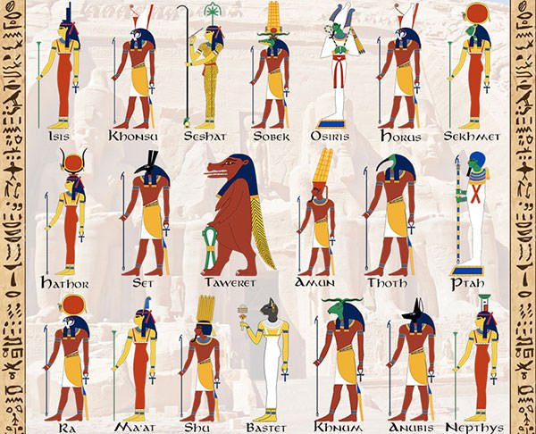
MONOTHEISTS only believe in ONE God
Christianity
Judaism
Islam
Sikhism
POLYTHEISTS believe in MANY Gods, or many forms of the same God
Ancient Egyptian.
Voodoo
Shinto

Slide 16

Theism
Monotheism
Polytheism
Atheism
Agnostic
Belief in God.
Belief in only one God.
Belief in more than one God.
Belief that there is no God.
Belief that God’s existence can never be proved or disproved.

Slide 17
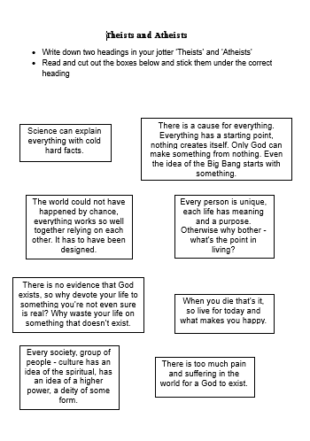
Lets check we are clear on the difference between an atheist and a theist and later we will link it to this way of gaining knowledge.
Complete the worksheet as instructed and then think Are they based on?
Are any of them weaker than others? Why?

Slide 18
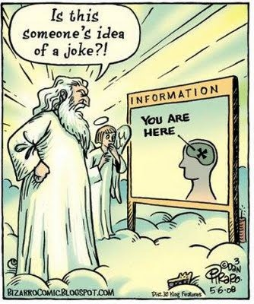
The point of the cartoon is?
In order to discover if God exists we need to ask ourselves how do we know if anything exists?
Is existence merely based on what we see or is there more to it than that?

Slide 19

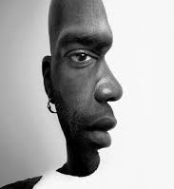

Slide 20
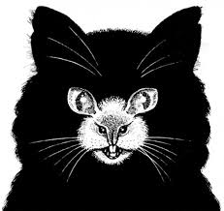
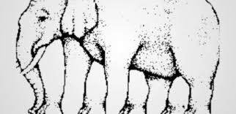

Slide 21

Our eyes are not trustworthy!
They can deceive us, so if we can’t rely on our senses, what else can we do to prove something exists.
Take love for example. How can we prove love exists?

Slide 22
There are 3 main ways that we can prove things exist.
Personal Experience – ‘I’ve seen it, so I know it exists.’
Reliable Evidence – ‘I haven’t seen it, but other people have convinced me so I accept that it does exist.’
Logical Reasoning – ‘I haven’t seen it, but there must be a logical reason to believe in it’s existence.”
Does one have more value than the others. Why? Which would you trust the most?

Slide 23
Are they based on?
Personal experience
Reliable evidence
Logical reason

Slide 24
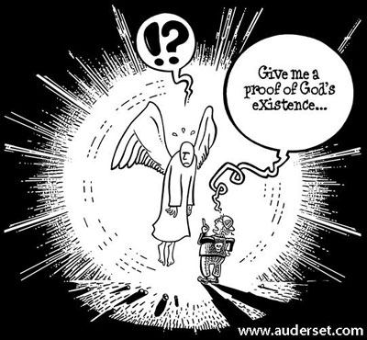
Proving that anything exists can be linked to proving that God exists.
Some people are certain that they have been in direct contact with God. Personal experience.
Some people accept the accounts of other people who believe that they have been in direct contact with God (and use it as evidence that God exists).Reliable evidence.
Some people believe that God is the only logical explanation for the origin of the universe and everything in it. Logical reason

